Slide 1


Lecture
Problems based on hashing Concepts

Slide 2
Recap
What is Hashing?
What are Hash Functions
Collisions
Load Factor
Applications of HashMaps
Introduction to the HashMap class
HashMap hierarchy
Working with the HashMap Class
Important features of the HashMap class
Working with HashMaps
Problems on HashMaps

Slide 3
Today’s Checklist
Problems on HashMaps

Slide 4
Ques: Valid Anagram
Check whether two Strings are anagram of each other. Return true if they are else return false.
An anagram of a string is another string that contains the same characters, only the order of characters can be different. For example, “abcd” and “dabc” are an anagram of each other.
Input1:
listen
silent
Output1:
true
Input2:
anagram
grams
Output2:
false

Slide 5
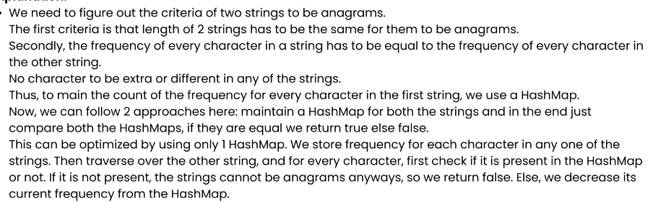
Delete

Slide 7
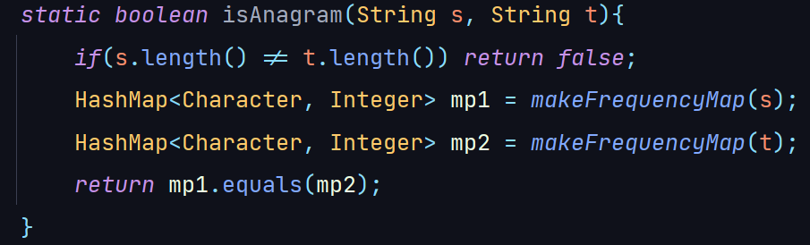
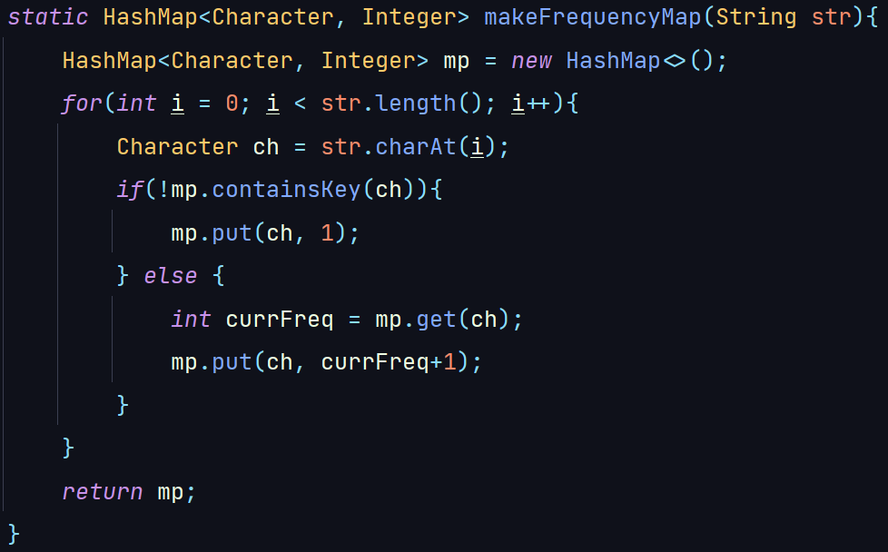
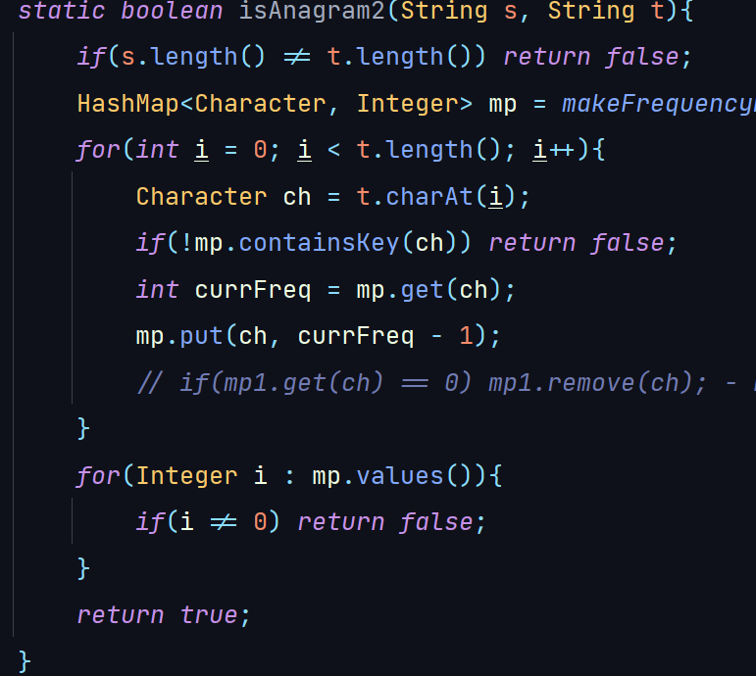

Slide 8
Ques: Isomorphic Strings
Given two strings s and t, determine if they are isomorphic.
Two strings s and t are isomorphic if the characters in s can be replaced to get t.
All occurrences of a character must be replaced with another character while preserving the order of characters. No two characters may map to the same character, but a character may map to itself.
Input1:
aab
xxy
Output1:
true
Input2:
abcdec
viouog
Output2:
false

Slide 10
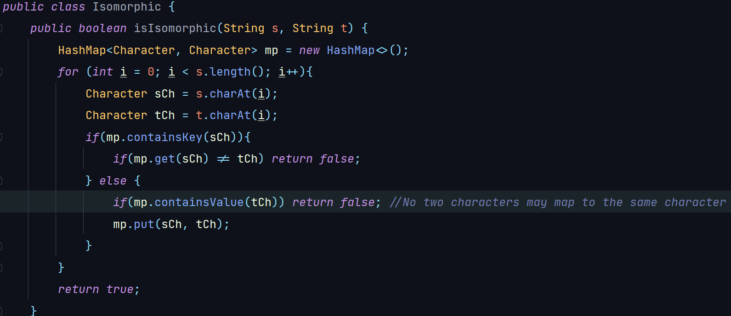

Slide 11
Ques: Two Sum
Given an array of length n and a target, return a pair(indices) whose sum is equal to the target. If there is no pair present, return -1.
Input1:
n = 4
arr[] = {1, 5, 7, -1}
target = 6
Output1:
0 1
Input2:
n = 10
arr[] = {10, 12, 10, 15, -1, 7, 6, 4, 2, 1}
target = 11
Output2:
0 9

Slide 13
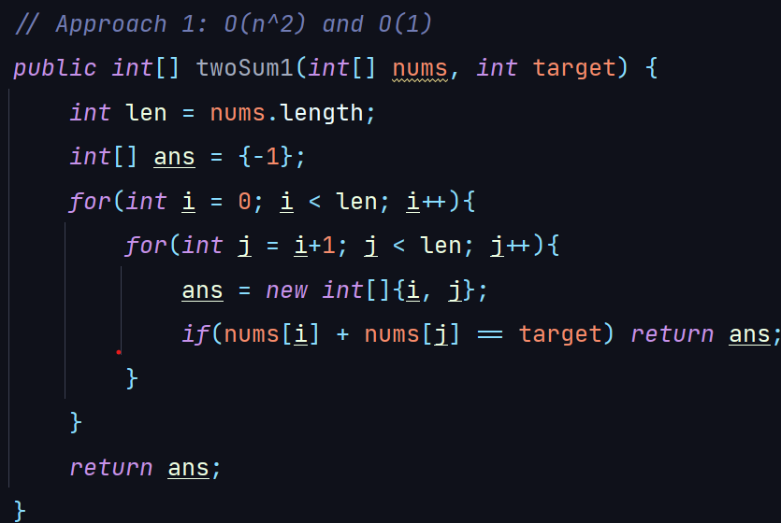

Slide 15
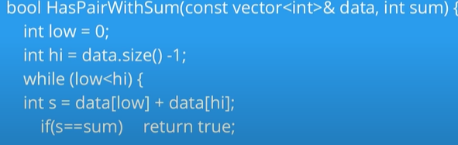
[Delete] High Level Approach - Two Sum II - Array is already sorted
Binary Search: O(nlogn)
2. Two Pointers: O(n)

Slide 17
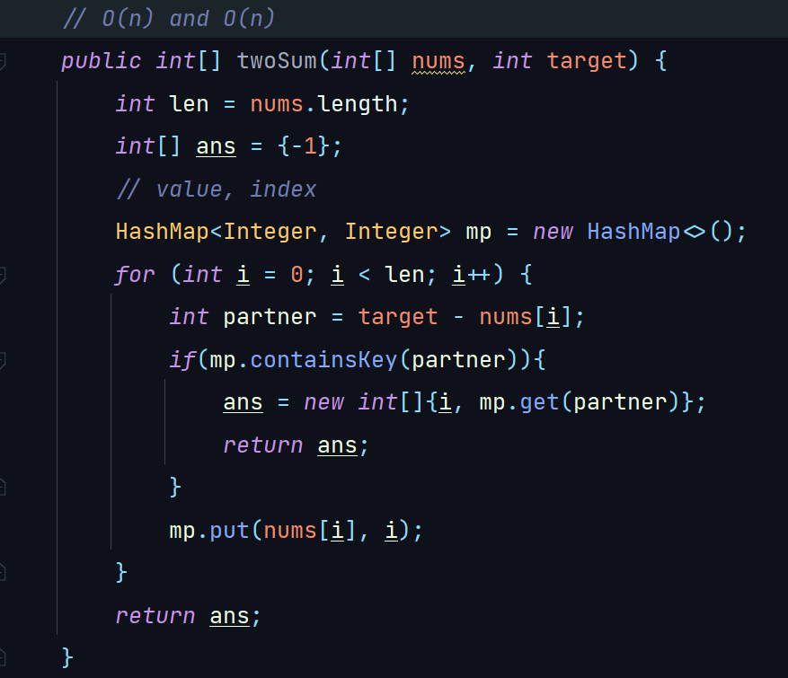

Slide 18
Ques: Largest subarray with 0 sum
Given an array arr[] of length N, find the length of the largest subarray with sum equal to 0.
Input1:
n = 8
arr[] = {15, -2, 2, -8, 1, 7, 10, 23}
Output1:
5
Input2:
n = 3
arr[] = {1, 2, 3}
Output2:
0

Slide 21
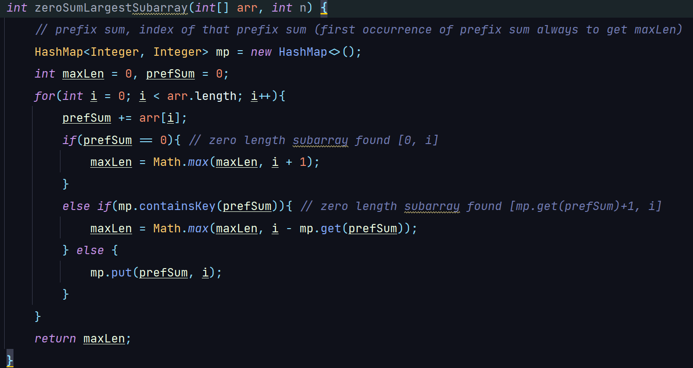

Slide 22
Next Lecture
Hashsets.

Slide 23
THANK YOU

